Slide 1
Grid Computing and Applications in China
Kai Nan
Computer Network Information Center (CNIC)
Chinese Academy of Sciences (CAS)
17 Mar 2008

Slide 2
Outline
Grid computing in China
Scientific Data Grid (SDG)
Applications and Virtual Laboratories
Prospect

Slide 3
Grid projects in China
CNGrid (China National Grid)
  Ministry of Science and Technology
  sites, GOS, applications grids
ChinaGrid
  Ministry of Education
  China Education and Research Grid
Network-based Science Research Environment
  National Science Foundation of China
Chinese Academy of Sciences
  Scientific Computing Grid
  Scientific Data Grid (SDG)

Slide 4
Overview of CNGrid
key project supported by the National High-Tech R&D Program (the 863 program)
earliest and largest Grid project in China
1st phase: 2002-2005
  ~100 million RMB from MOST
2nd phase: 2006-2010
  ~300 million RMB from MOST

Slide 5
CNGrid’s computing resources
1st phase (by 2006)
  Total about 18 TFlops
    CAS Network Center 5.3TFlops
    Shanghai Supercomputer Center 10.2 TFlops
    Tsinghua University 1.1 TFlops
    Institute of Applied Physics and computational Mathematics 0.3 TFlops
    University of Science and Technology of China 0.3 TFlops
    Xi’an Jiaotong University 0.6 TFlops
    NUDT 0.1 TFlops (1TFlops)
    Hong Kong University 0.3 TFlops
2nd phase: 300 TFlops

Slide 6
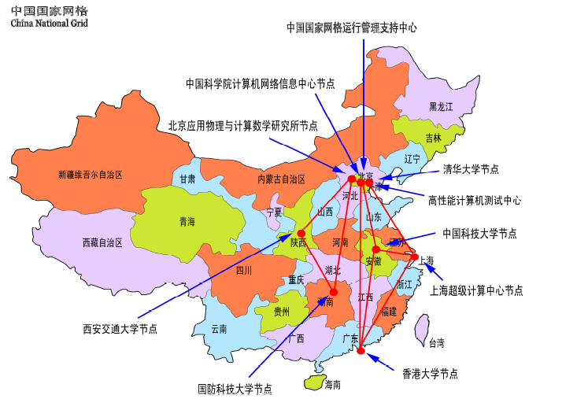

Slide 7
CNGrid operation & support center
Based on CNIC
Major tasks
  Operational management of CNGrid
  User management
  Security management
  Software maintenance
  Technical support
  User training

Slide 8
Grid software development
Grid system software
  Interfacing to heterogeneous systems
  Resource management
  scheduling
Grid application development environment
  Portal based
Grid user environment
  Grid browser
  GSML

Slide 9
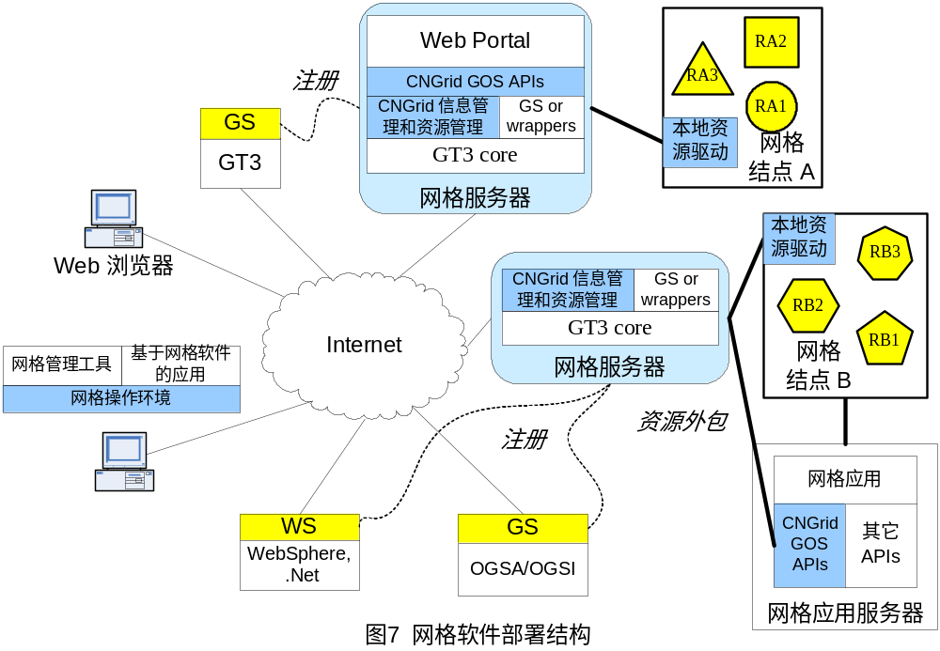
Deployment of grid software 1.0/2.0

Slide 10
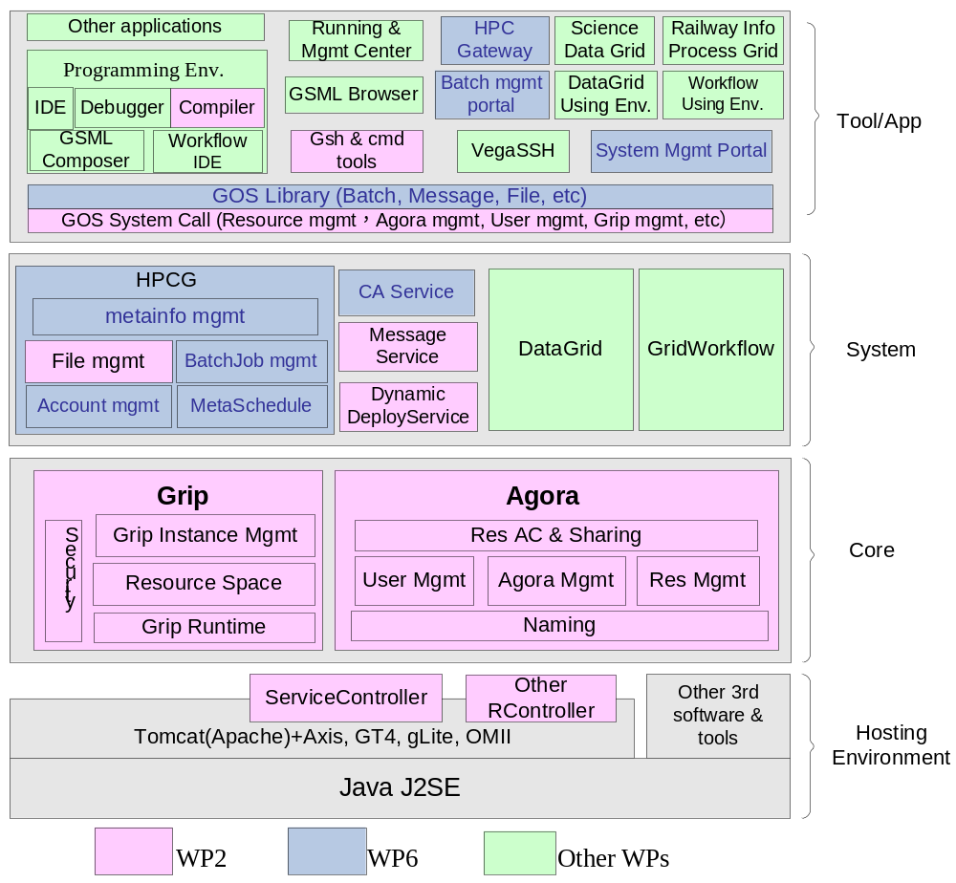

Slide 11
Application grids development
Applications from selected areas
  Resource and Environment
    GSG, DFG, SeisGrid
  Research
    SDG, BAGrid, DDG, ChinaGrid
  Services
    CMAG, ITG
  Manufacturing
    AviGrid, SimGrid

Slide 12
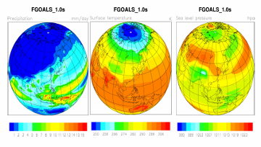
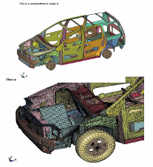
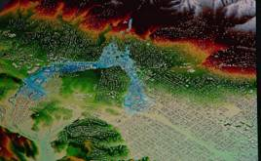
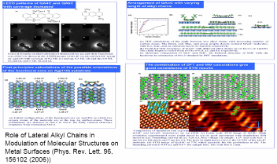
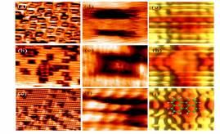
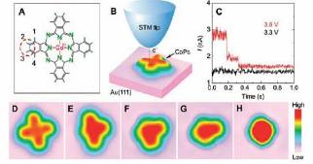
CNGrid Application Grid
Bio-informatics Grid
Manufacturing Grid
Simulation grid
……
Drug discovery grid

Slide 13
CNGrid Application Grids -1
Geological Survey Grid
  by China National Geological Survey Bureau
    Nation-wide productive grid
    Data exchange and sharing
    Resource evaluation services
  Shorten the evaluation time from 3 years to 3 months
  Delivering achievements in
    North China ground water resources evaluation
    Mineral resources evaluation
Digital Forestry Grid
  by the Institute of Forest Resources Information
  Support project of turning the farmland back to forests
    potential evaluation
    project planning
    project evaluation
  Forest resource information services

Slide 14
CNGrid Application Grids -2
China Meteorological Application Grid
  Undertaken by China National Meteorological Center
  Multiple sites to form the research platform for new weather prediction model research
  Provide new weather forecast services (time and location-specific)
New drug discovery grid
  Undertaken by Shanghai Institute of Materia Medica CAS
  Compound screening for new drug discovery
    Speed up the process by computer simulation
    Higher accuracy
  Using HPC in P2P mode
  New drug for diabetes is under development and will enter clinic testing by the end of 2005

Slide 15
CNGrid Application Grids -3
Bioinformatics Applied Grid
  Undertaken by Beijing Genomics Institute, CAS
  Provide computing, data, and information grids for bio-information research in the country
AviGrid
  Undertaken by AVIC II of China
  Support distributed design, simulation, and manufacturing
    CAD software sharing
    Data exchange and sharing
    Computing resource sharing
Scientific Data Grid
  Undertaken by CNIC, CAS

Slide 16
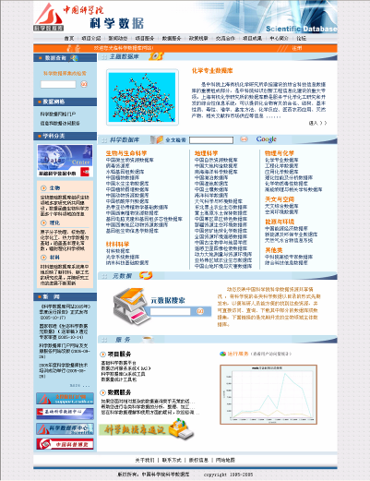
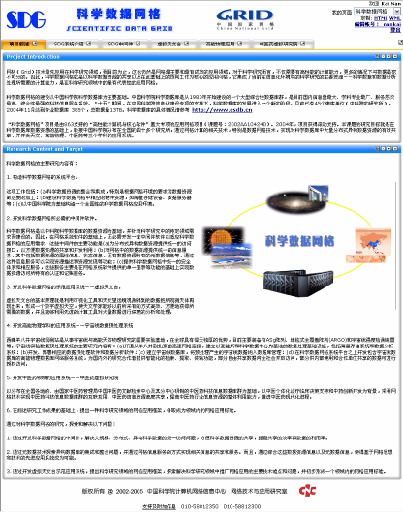
Scientific Database (SDB)
& Scientific Data Grid (SDG)
45 institutes participated
503 databases
16.6 TB
236-CPU Superserver (1TF)
20TB Disk Array
50TB Tape Library
VizWall & Access Grid

Slide 17
What SDG provides
DAS (Data Access Service)
IMS (Information and Metadata Service)
Security Infrastructure
Storage Service
SDG Portal

Slide 18





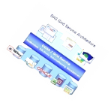
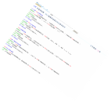
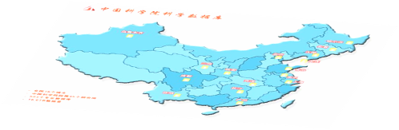
Scientific Data Grid Applications
Avian Flu Alert System
Other Grids
Virtual Observatory Grid
High Energy Physics Grid
Scientific Data Grid
Scientific Data Grid Middleware
Scientific Database

Slide 19
SDG-DAS
Goal:
  Access 500+ databases in 45 institutes
  Provide uniform interfaces (web/grid service) for researchers
Functions
  Metadata extraction
  Database schema mapping
  Block data set
  GT3/GT4/CROWN/GOS compatible

Slide 20
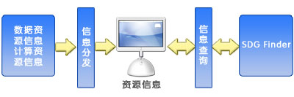
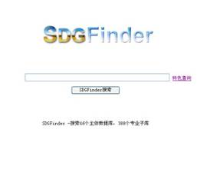
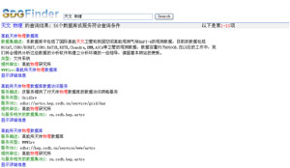
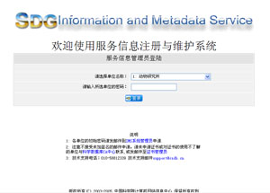
SDG-IMS
Based on scientific metadata
Provides resource publishing, storage, discovery
Two basic modules:
  Information dissemination
  Information search

Slide 21
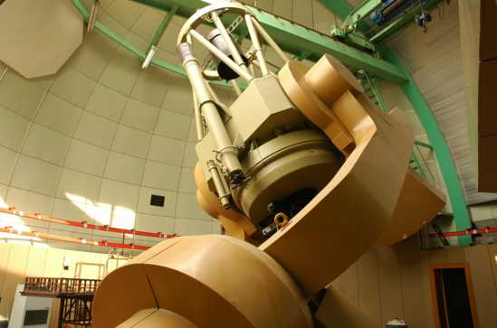
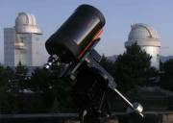
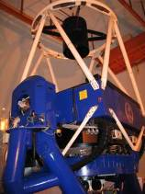



AVLAB - Telescopes from 4 places
Xinglong Observatory
Shanghai sheshan
Huairou Observatory
Yunnan lijiang

Slide 22
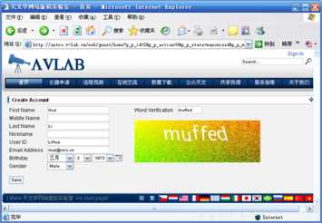
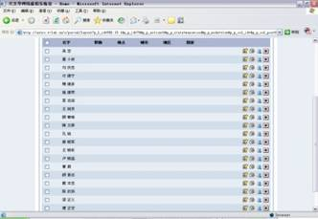
Open and stable services
7*24 stable service
  funded by avlab projects
  supported by education
Open to public, everyone can use and register
Now almost 80 users are registered

Slide 23
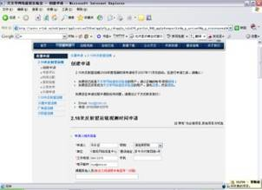
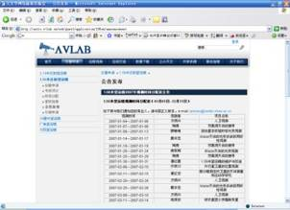
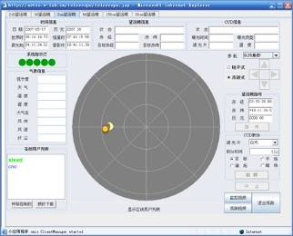
Scientific activity support
Apply for the use of
telescope online
Telescope collaborative
observation platform
Give a universal operation
interface for all telescope
Scientists can share ideas
to others online

Slide 24
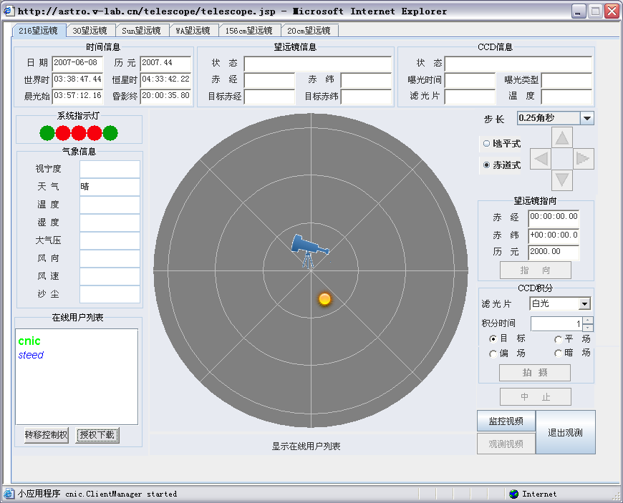
Notes:
此时打开的页面就是各望远镜的远程操作界面。
1、通过选择页面顶部的标签，用户可以在不同望远镜的远程操作界面间切换，即同一个用户可以在同一个时段内操作两台或两台以上的望远镜。
2、标签正下方及页面左侧中部是望远镜相关信息显示面板，包括时间信息、望远镜信息、CCD信息以及望远镜所在地区的气象信息。
3、气象信息上方是系统指示等，通过该指示灯，用户可以了解望远镜各个设备部件当前是否工作正常。
4、页面中部是望远镜当前指向位置的图形显示面板。
5、页面右侧是望远镜指向及拍摄控制面板。
6、页面右下角是望远镜监控视频和观测视频控制按钮。
7、页面左下角是在线用户列表，显示的用户是当前同时使用该望远镜进行协同观测的所有用户。主控用户还可以通过该列表将望远镜的控制权临时转交给参与此次协同观测的其他在线用户，或给某个用户授予下载观测结果的权限。

Slide 25
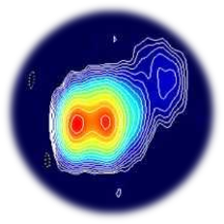
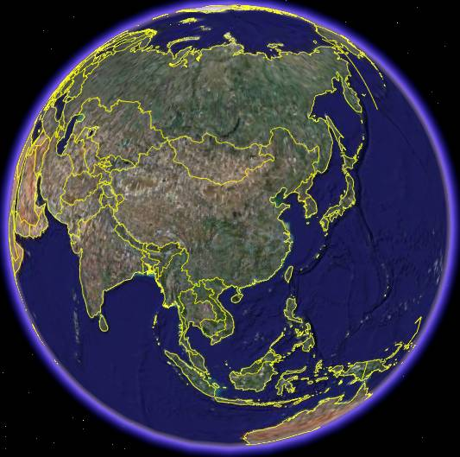





July 25, 2007
Beijing – Shanghai Blazer Multi-band joint observation
国家天文台
2.16米望远镜
B波段
上海天文台
1.56米望远镜
R波段
Notes:
自2006年建成以来，天文学网络虚拟实验室在多次天文观测任务中发挥了重要作用。2007年7月25日，为了研究Blazer天体的光变行为，国家天文台、上海天文台以及中科院网络中心的3名科研人员在家中通过天学网络虚拟实验室与兴隆和佘山观测基地的2名科研人员协作，圆满完成了Blazer天体B波段和R波段的同时监测任务，取得了预期的科研成果。

Slide 26
VLAB Project
Exploration of e-Science Virtual Lab with our vision
A product under Virtual Lab concept
Not only middleware
focus on an e-Science environment for true science applications

Slide 27














Architecture of VLAB
Virtual Workbench
Resources & services
CA
Core toolkit
Scientific Workflow
VO management
Computing
Resource Plugin
AV Plugin
Document Collaboration
Device Plugin
Database Plugin
Activity Collaboration
Didital Library Plugin
Other Plugins

Slide 28
core components of VLAB
Virtual Workbench
Core Toolkits
e-Science Security Infrastructure
Virtual Labs services

Slide 29
Virtual Workbench
A universal portal for e-Science activities
  Open, scalable, flexible integrated platform for different resources
  Support flexible requirements from scientists
  Support component reuse
  Assure usable and accessible

Slide 30
Core Toolkits
User Management Tool
  VO oriented
Document Collaboration Tool
Activity Arrangement Tool

Slide 31
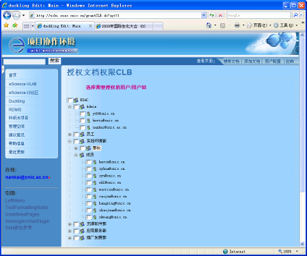
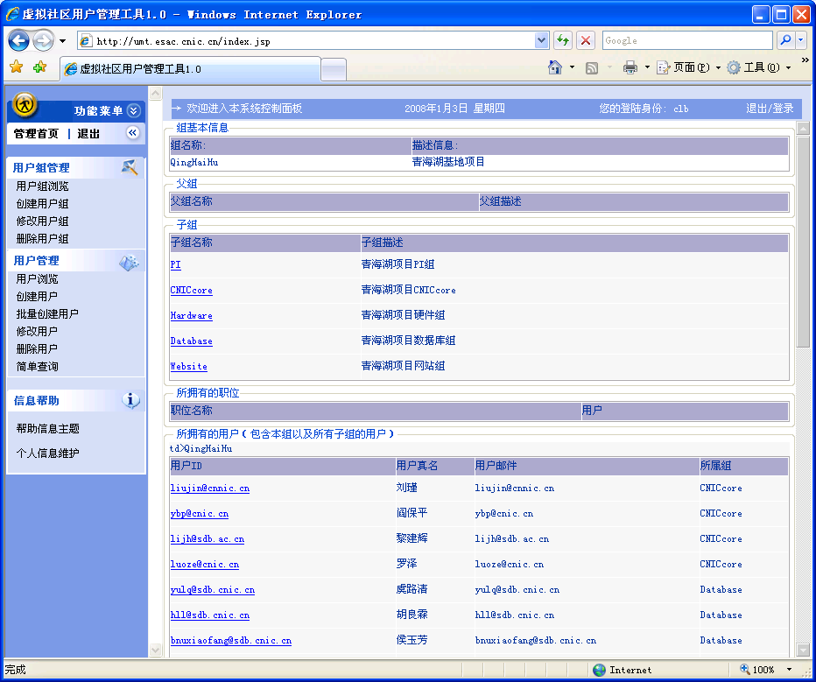
UMT

Slide 32
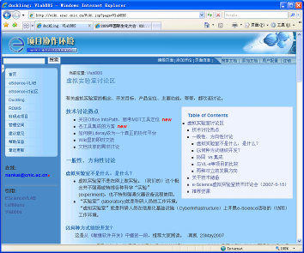
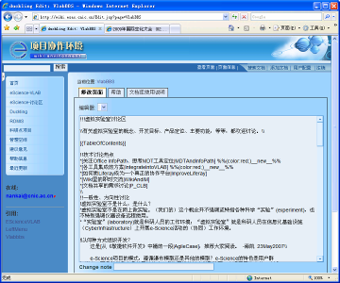

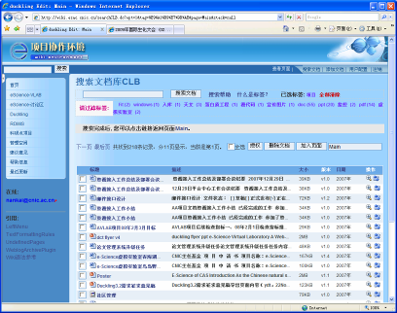
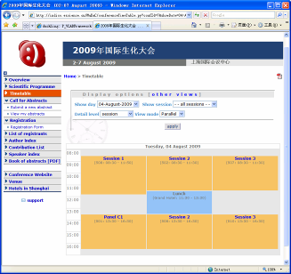
DCT
AAT

Slide 33
Prospect
Work with partner scientists to develop and deploy Virtual Lab
  Biology, Astronomy, High Energy Physics, ...
Step by step, case by case, project by project, move forward towards e-Science
Grid survives on applications

Slide 34
Thanks

